Slide 1

Vehicle frame
Politecnico di Torino – MSc Automotive Engineering
Numerical Modelling and Simulation – Part A – prof. Alessandro Scattina
Accademic year 2024/2025
Tommaso Massone

Slide 2
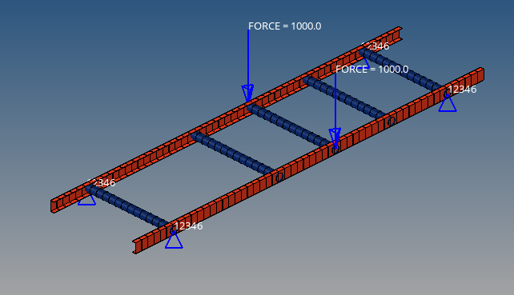
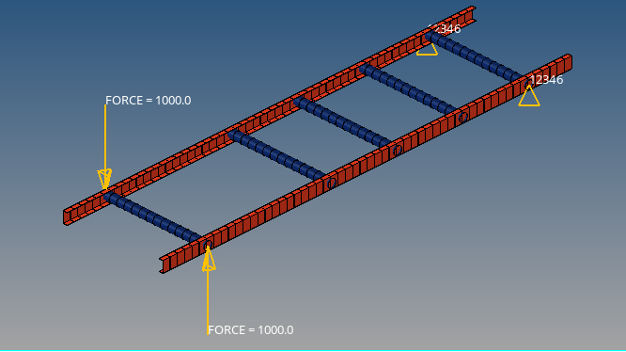
Creation of the model
Definition the section of the 2 components of the frame, longitudinal members and cross beams, as required
Definition of the material, steel and the 2 proprieties, 1 for the longitudinal members and 1 for the cross beams, each one with the respective cross-section
Creation of 2 different load collectors, 1 for bending situation and 1 for the torsion one, inserting in each one the constraints and the loads, in order to evaluate the bending and the torsion stiffnesses
Application to each component of the respective property and material
Creation of 2 different loadsteps, one for each loading case.
Bending case
Torsion case

Slide 3




Stiffness analysis
Evaluation of bending stiffness
Evaluation of torsion stiffness
$$K_{bend}=\frac{F_{tot}}{∆z}$$
$$K_{tors}=\frac{Torque}{α_{YZ}}$$
$$K_{bend}≈596\frac{N}{mm}$$
$$K_{tors}=\text{72405} \frac{Nm }{rad}$$

Slide 4
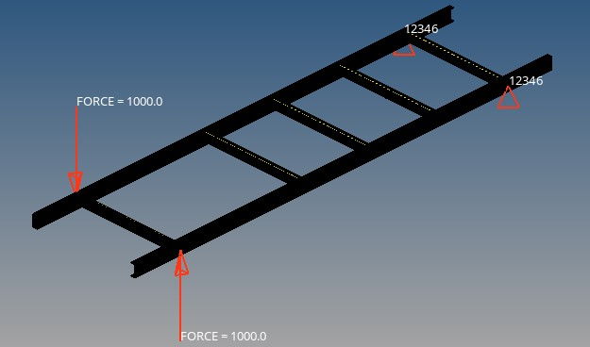
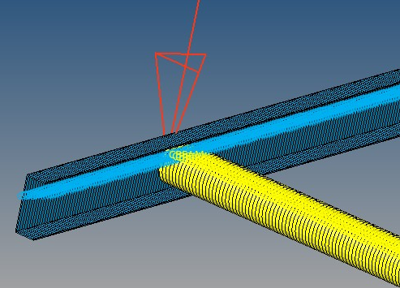
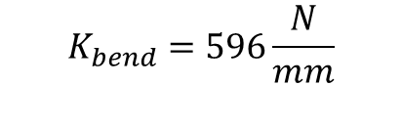

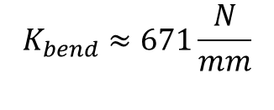

Influence of different parameters on the results
Same shape but different material, Titanium : E=116 Gpa, ν = 0.34, ρ = 4,5e-9 Gkg/m^3
$$K_{bend}≈671\frac{N}{mm}$$
$$K_{tors}=\text{39698}\frac{Nm}{rad}$$
Same shape but different mesh size, choosing an element misure of 10, instead of 100
$$K_{bend}=596\frac{N}{mm}$$
$$K_{tors}=\text{72405}\frac{Nm}{rod}$$

Slide 5
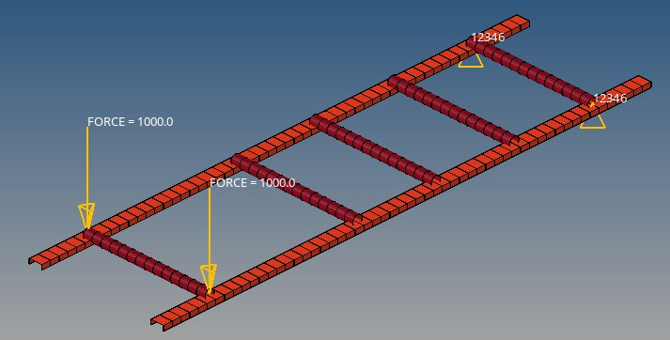
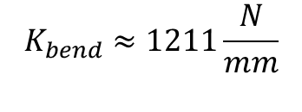

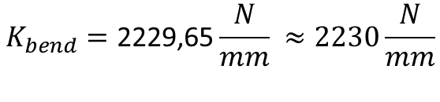

Same section with increase in thickness : 6mm instead of 3mm
$$K_{bend}=\text{2229,65}\frac{N}{mm} ≈2230\frac{N}{mm}$$
$$K_{tors}=\text{14}4543\frac{Nm}{rad}$$
Same section but the 2 long-beams are rotated, the C beam is facing the bottom
$$K_{bend}≈1211\frac{N}{mm}$$
$$K_{tors}=\text{570098}\frac{Nm}{rad}$$

Slide 6
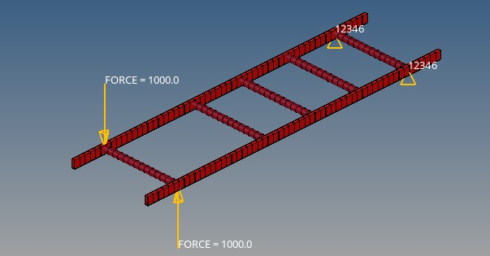
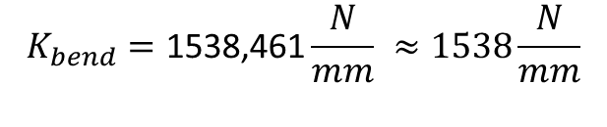

Different section for the long-beam: instead of C beam a box beam is chosen
$$K_{bend}=\text{1538,461}\frac{N}{mm} ≈1538\frac{N}{mm}$$
$$K_{tors}=\text{1349}30\frac{Nm}{rad}$$

Slide 7
Results
Case | Bending Stiffness | Torsional stiffness
 | [N/mm] | [Nm/rad]
Reference (steel) | 596 | 72405
Ref with smaller mesh elements (10) | 596 | 72405
2 x thickness | 2230 | 144543
Titanium material | 671 | 39698
Box beam section | 1538 | 134930
C beam diff. Orientation | 1211 | 570098
Changing the material, different results are found: the torsional stiffness is lower, directly correlated to a lower E, while the bending stiffness is a bit higher due to intrinsic property of material.
Both stiffnesses increase also if the C beams are rotated; this is due to the fact that the orientation of the section in this case improves the behavior of the structure
Just changing the section and not the thickness it is possible to see how a close section increases the stiffness of the structure because this increases the inertia moment of the section
It was expected that increasing the thickness of the beam both bending and torsional stiffness are increased, as the moment of inertia of the section increases.

